Slide 1

predicting post-operative length of stay
Using machine learning to improve care and improve utilization
Jamie Lepard
Product Strategy, Health Futures
November 10th, 2023

Slide 2


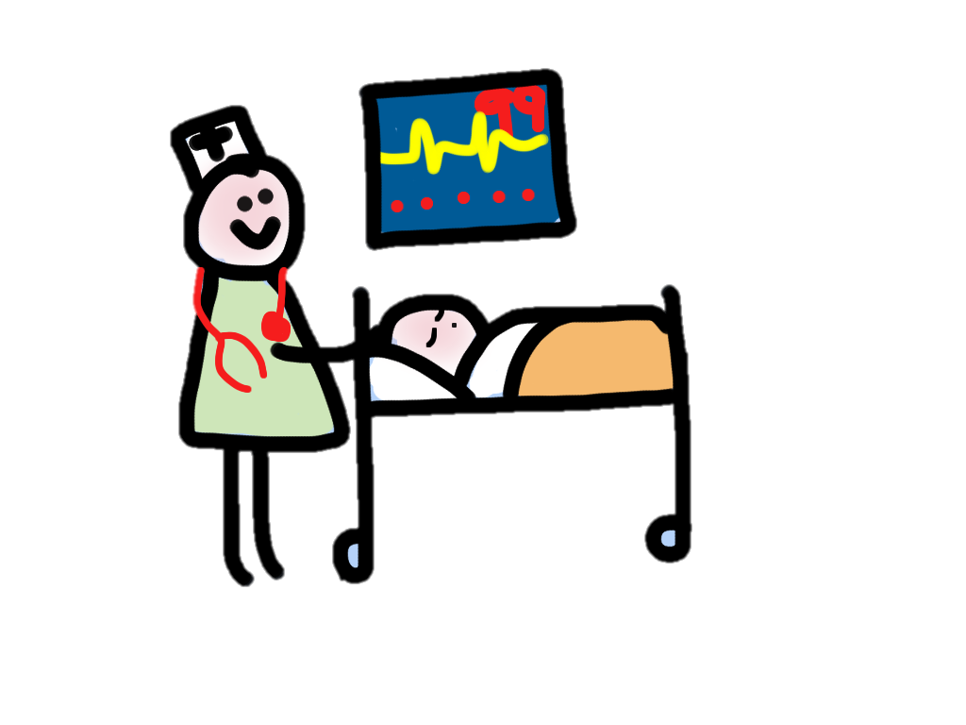



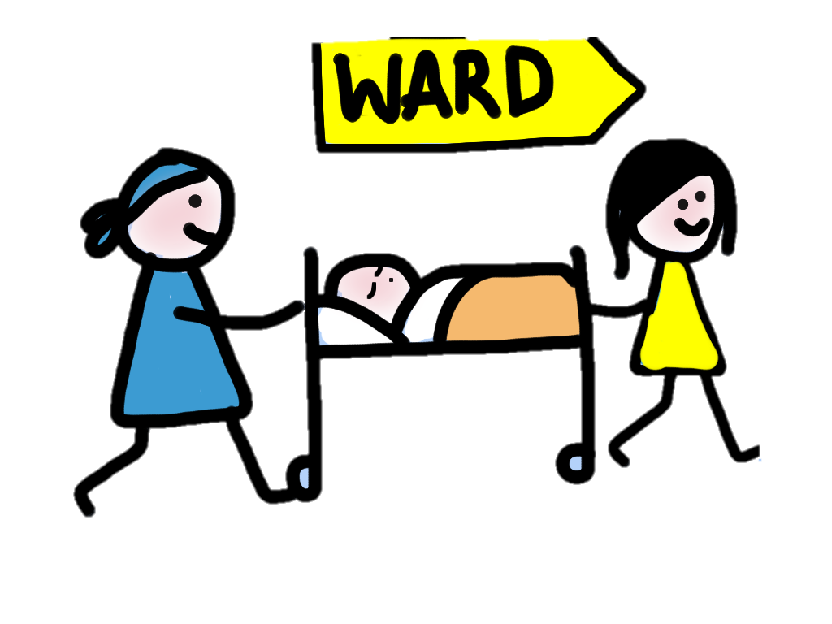

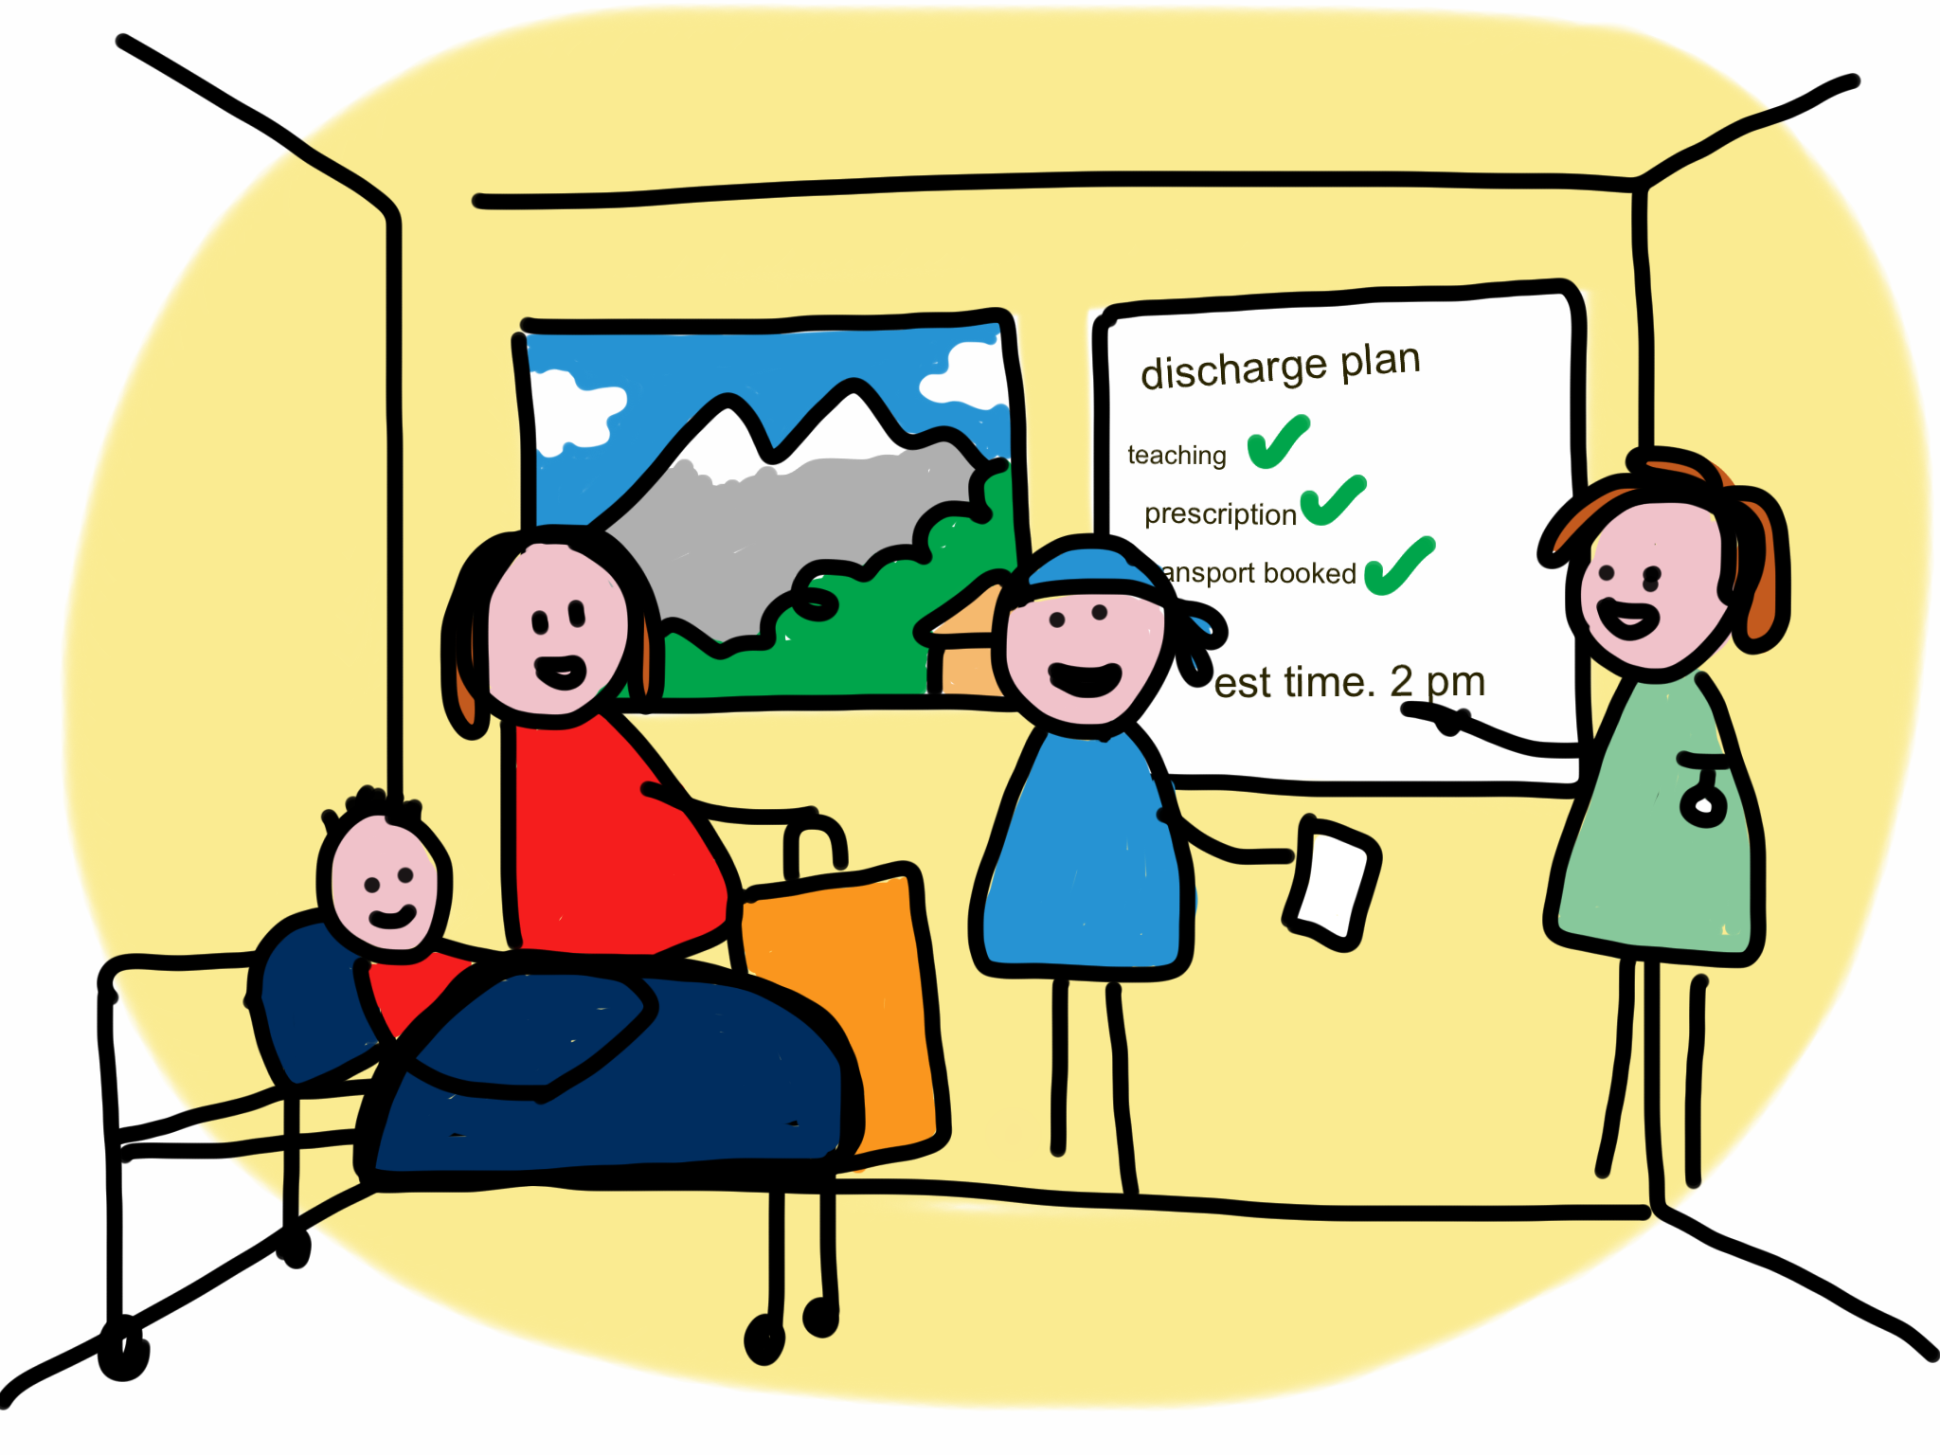



PROBLEM STATEMENT illustrated:
What if we could predict this day much earlier?
Immediately following surgery
Illustrations:
Liz Lamb
transfer to ward
care pathway
discharge plan
home
waiting..
surgery
recovery
No beds post-op means cancelled surgery
There are a limited number of beds
Patients need to be discharged so more get care

Slide 3
OPPORTUNITY

Slide 4
APPROACH

Slide 5
RESULTS

Slide 6
Next steps

